Slide 1
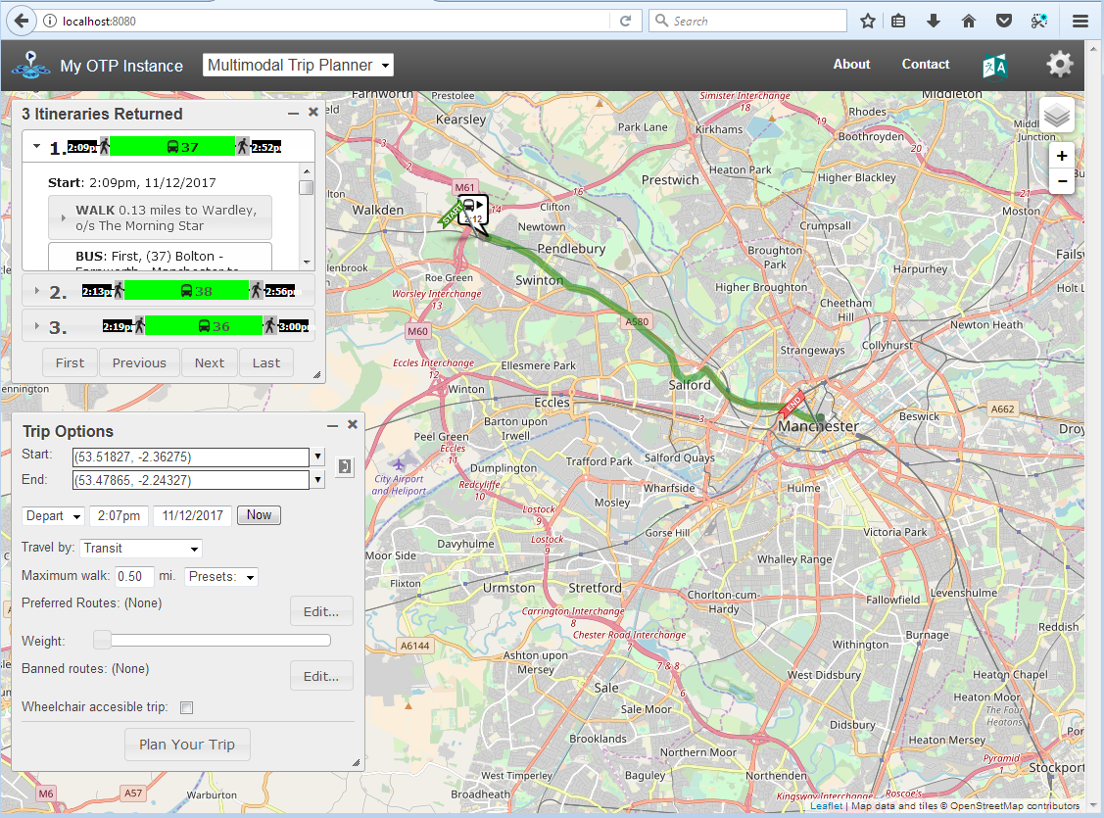

OpenTripPlanner – creating and querying your
own multi-modal route planner
Marcus Young
Transportation Research Group
University of Southampton
16 November 2017

Slide 2
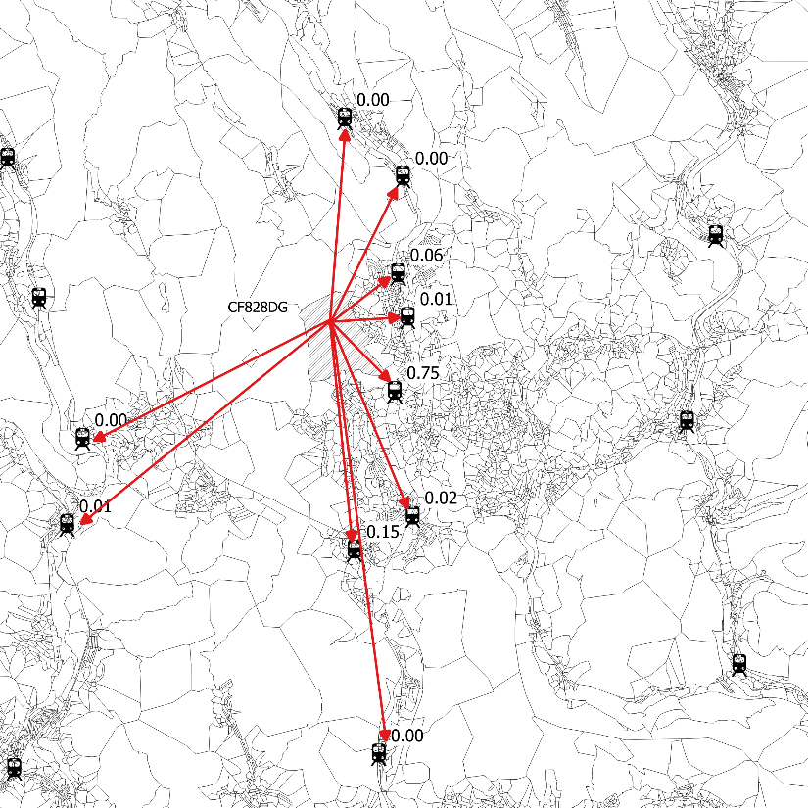
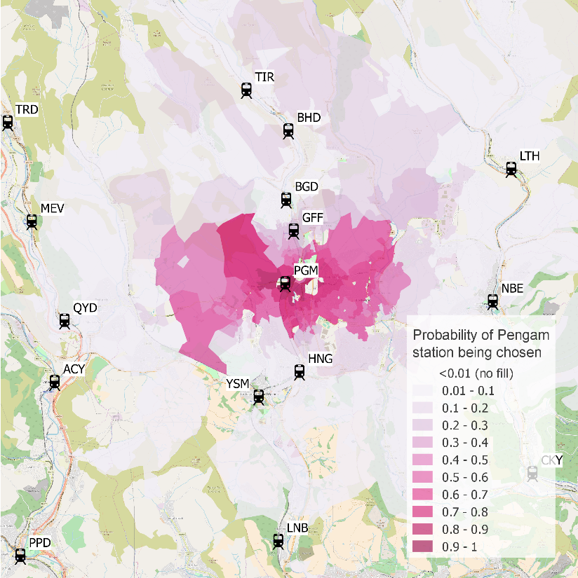
Key part of my research was developing station choice models to define probabilistic station catchments
Probability of alternative stations being chosen for a postcode
Probabilistic catchment for a station

Slide 3
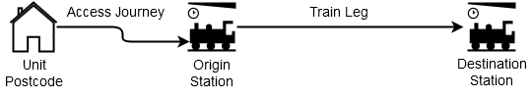
To calibrate models I needed data on station access journeys and the train leg
individual | Choice set | Chosen | Distance (road) | Time (road) | Duration (mode specific) | Train leg duration | Walk time | Wait time | Transfers | On-train time | Fare
1556 | ADR | 1 | 0.64 | 2.48 | 9.40 | 28.33 | 2.33 | 0 | 0 | 26 | 6.40
1556 | COA | 0 | 2.06 | 6.13 | 26.63 | 26.33 | 2.33 | 0 | 0 | 24 | 6.20
1556 | WFF | 0 | 3.94 | 12.93 | 41.12 | 43.00 | 0.00 | 6 | 1 | 37 | 6.40
1556 | CBC | 0 | 3.85 | 13.20 | 50.12 | 41.00 | 0.00 | 6 | 1 | 35 | 6.40
1556 | HLY | 0 | 7.66 | 16.03 | 83.55 | 34.10 | 8.10 | 0 | 0 | 26 | 6.90
1556 | KWD | 0 | 5.69 | 20.10 | 68.62 | 58.10 | 8.10 | 0 | 0 | 50 | 6.20
1556 | BAI | 0 | 5.17 | 14.73 | 65.30 | 19.33 | 2.33 | 0 | 0 | 17 | 5.80
1556 | CBS | 0 | 3.85 | 11.27 | 48.67 | 23.33 | 2.33 | 0 | 0 | 21 | 5.90
1556 | CRF | 0 | 8.22 | 17.32 | 97.47 | 36.10 | 8.10 | 0 | 0 | 28 | 6.90
1556 | DRU | 0 | 3.35 | 8.92 | 37.18 | 33.33 | 2.33 | 0 | 0 | 31 | 6.70

Slide 4
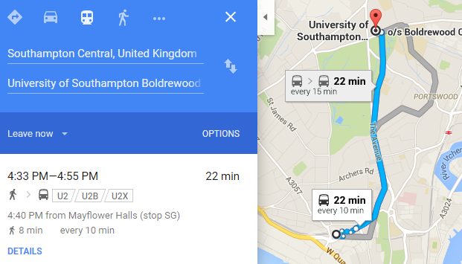
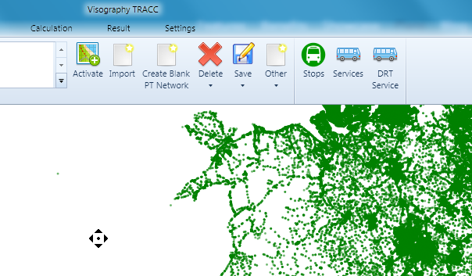
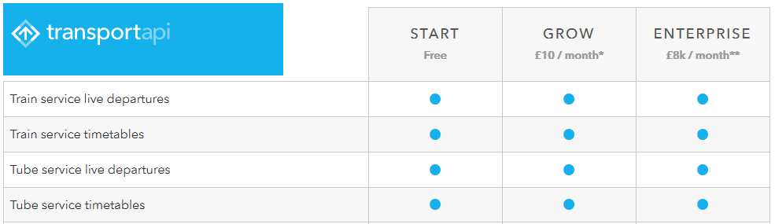
Variety of route planning tools were considered, but found unsuitable and rejected
Commercial desktop options – expensive, and restrictive.
Online services - not free and restricted to current services - not useful for planning or retrospective analysis

Slide 5
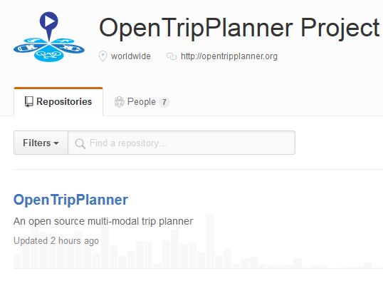
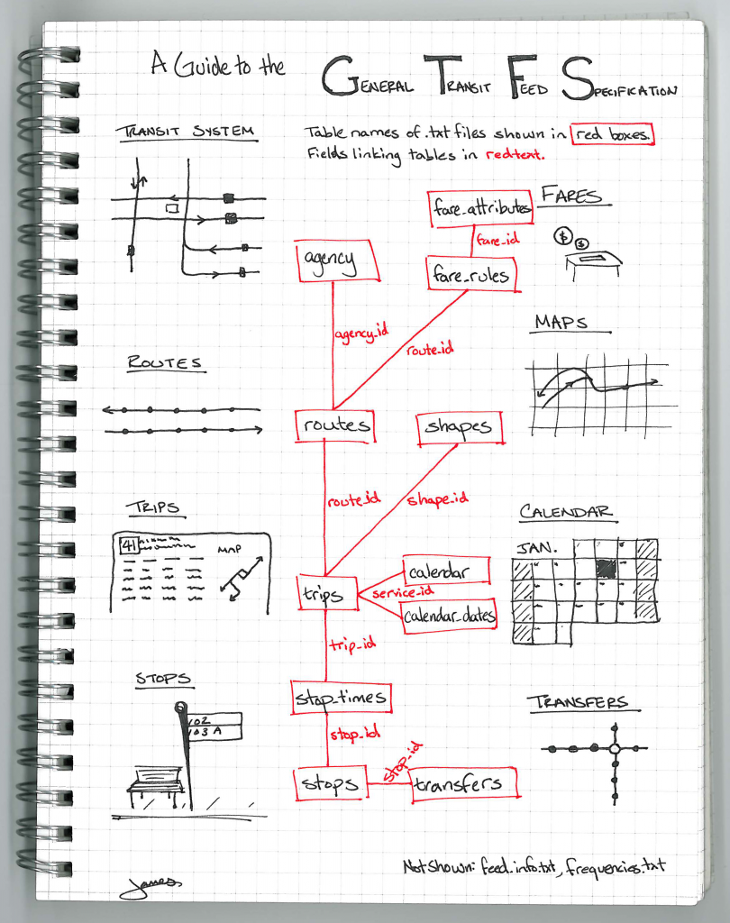
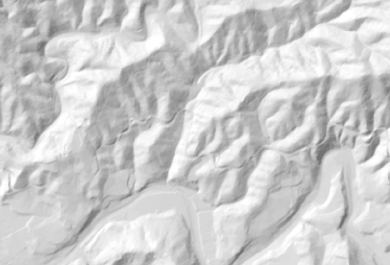
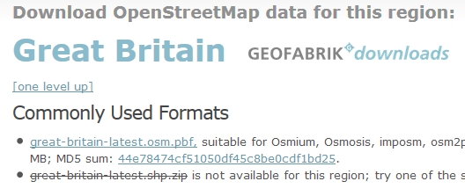
OpenTripPlanner was selected – open source, cross-platform, with web interface and routing API
GTFS
GeoTIFF
OpenStreetMap
Source: http://blog.openplans.org/2012/08/the-openplans-guide-to-gtfs-data/

Slide 6
An automated framework to derive explanatory variables from disparate open transport data sources
From: Young, Marcus. 2016. “An automated framework to derive model variables from open transport data using R, PostgreSQL and OpenTripPlanner.” Paper presented at 24th GIS Research, UK Conference.

Slide 7
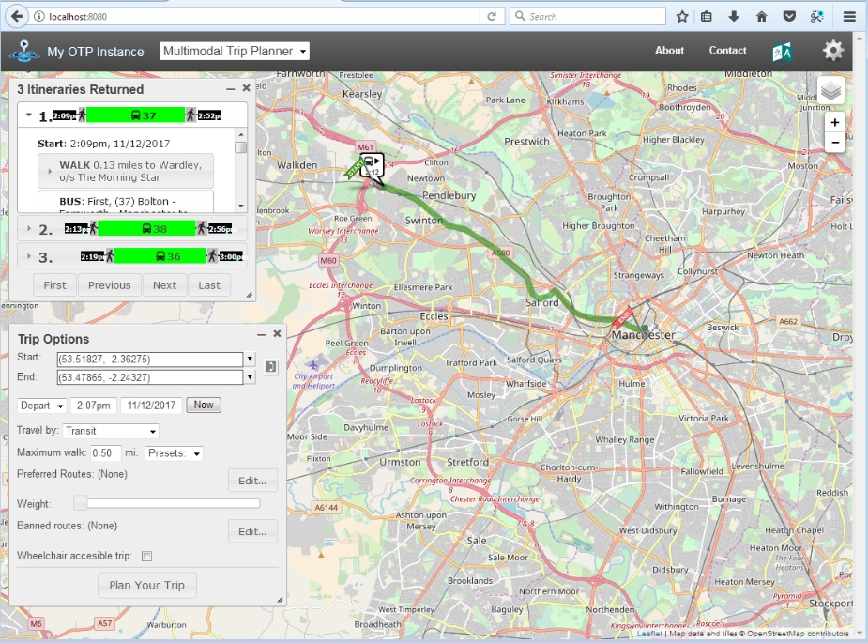
Tutorial – Part 1 (approx. 25 mins)
Build an OTP network graph for Greater Manchester and then launch your OTP instance and test the web interface.
https://github.com/marcusyoung/otp-tutorial
intro-otp.pdf
materials.zip

Slide 8
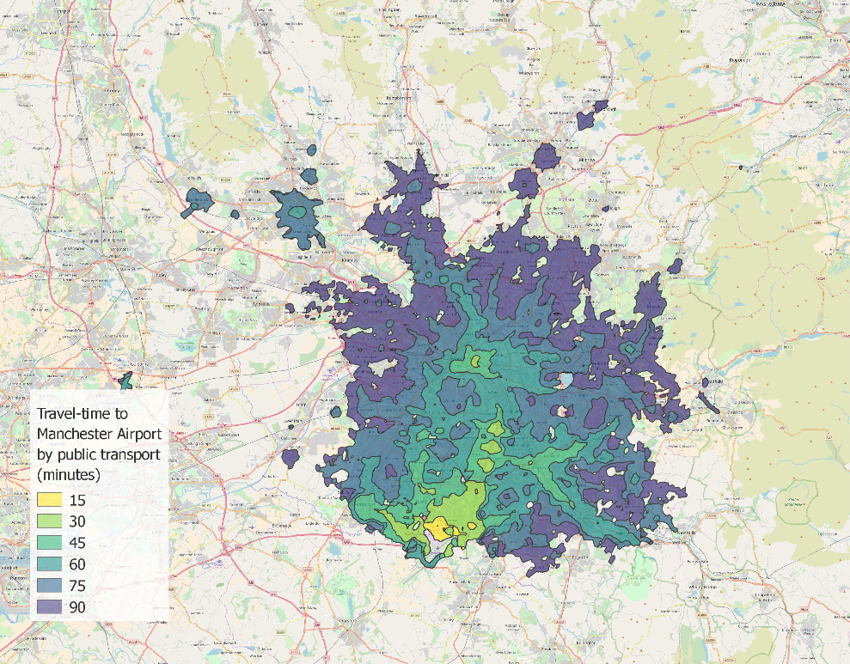
Tutorial – Part 2 (approx. 40 mins)
Query the OTP Isochrone API to obtain travel-time polygons for accessing Manchester Airport.
Assess impact of new service
No OTP instance? Use: otp.graspit.co.uk

Slide 9
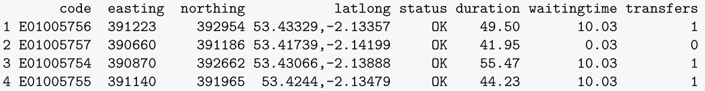
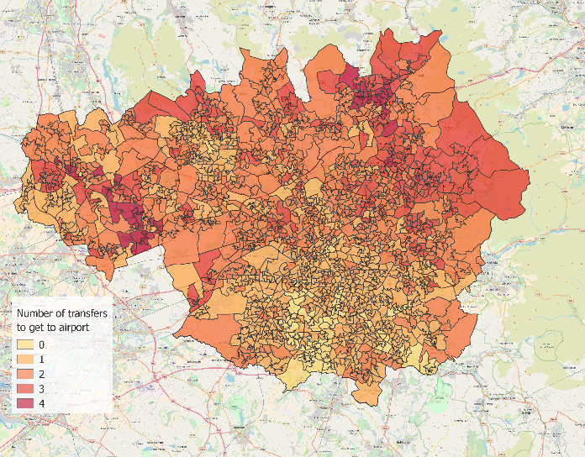
Tutorial – Part 3 (approx. 40 mins)
Use an R script to automate querying the OTP route planner API
Look up route to Manchester Airport by public transport for each LSOA in Greater Manchester

